Slide 1
Instacart Analysis (Product Recommendation and Market Basket Analysis)
PRESENTED BY
Ranjith Reddy M
UNDER GUIDANCE OF
DR. Chaojie Wang

Slide 2

Content
Introduction
Objective
About Datasets
Exploratory Data Analysis
Logistic Regression
Clustering
Deployment
Conclusion
Future Scope
References

Slide 3
Introduction
Instacart is an American company that operates as a same-day grocery delivery service. Customers can select groceries through a web application and the order is reviewed and delivered by personal shoppers through various retailers. With the large customer base, the company collects data of the user's transactions behavior and purchasing history. The dataset contains a sample of over 3 million grocery orders from more than 200,000 Instacart users.
Currently they use transactional data to develop models that predict which products a user will buy again, try for the first time, or add to their cart next during a session.

Slide 4
Objective
The objective of this capstone is to address two research questions:
Predict whether a product will be reordered or not in the future by the customers using Logistic regression.
Product Recommendation using Association rule mining and K- Means Clustering
The ability to identify which products the customers are likely to purchase again, and automatically adding those to cart through obtained predictions and also using product recommender.

Slide 5
Project flow
Data Extraction
Data Cleaning
Feature Selection
Modeling
Deployment

Slide 6
About Datasets
Table Name | Column Names | Description | Hypothesis for Data Exploration
aisles | aisle_id, aisle | 134 unique IDs, names for different aisles at Instacart | aisle which generates highest revenue, most frequently used aisle, distribution of aisle usage based on demographics and other customer info, is there a trend of aisle popularity with time of day, day of week, or any specific month of year?
departments | department_id, department | 21 unique IDs, names for different departments including 'missing' - looks like the rolled-up metric for aisles e.g. one department might have multiple aisles | revenue by dept, frequency of use by dept, distribution of dept usage based on demographics and other available customer info, dept popularity by time of day, day of week, or any specific month of year
order-products-prior | order_id, product_id, add_to_cart_order, reordered | 32,434,489 rows at order-product level with 3,214,874 unique orders for 49,677 unique products. 'add_to_cart_order' shows the order in which they were added to the cart and 'reordered' | most ordered products, most frequent re-ordered products, products which are only ordered once and not reordered, Number of products in one order, are the products that are ordered together from the same aisle/dept?
order-products-train | order_id, product_id, add_to_cart_order, reordered | Similar to df_prior_orders but only has latest order information. 1,384,617 rows with 131,209 unique order IDs and 39,123 | most ordered products, most frequent re-ordered products, products which are only ordered once and not reordered, Number of products in one order, are the products that are ordered together from the same aisle/dept?
orders | order_id, user_id, eval_set, order_number, order_dow, order_hour_of_day, days_since_prior_order | 3,421,083 orders showing information on order ID, user ID, which evaluation dataset the order is in (prior, train, test), day of week, hour of day, days since prior order | Most popular day & time for placing an order, trend of day & time by products
products | product_id, product_name, aisle_id, department_id | 49,688 rows mapping products to aisles and departments | covered in above metrics

Slide 7
Time effects on purchasing behaviors
Most orders are ordered on Day 0 and Day 1.
Orders are mostly ordered during day, from 9:00 AM to 4:00 PM.
Peak orders happens at Saturday afternoon (1:00PM), and Sunday morning (10:00AM).
By more than 65%, People usually buy previously ordered products from 6:00AM to 8:00AM.
Most users make orders after a week from their last order. or from a month of their last order.
After a week from the last order, the probability of reordering within the same month is small.
Send reminders of the most likely ordered products within a week, to catch the high prob of a customer to make their next order.
The Next order has higher probability to be during 10 days from the current order.

Slide 8
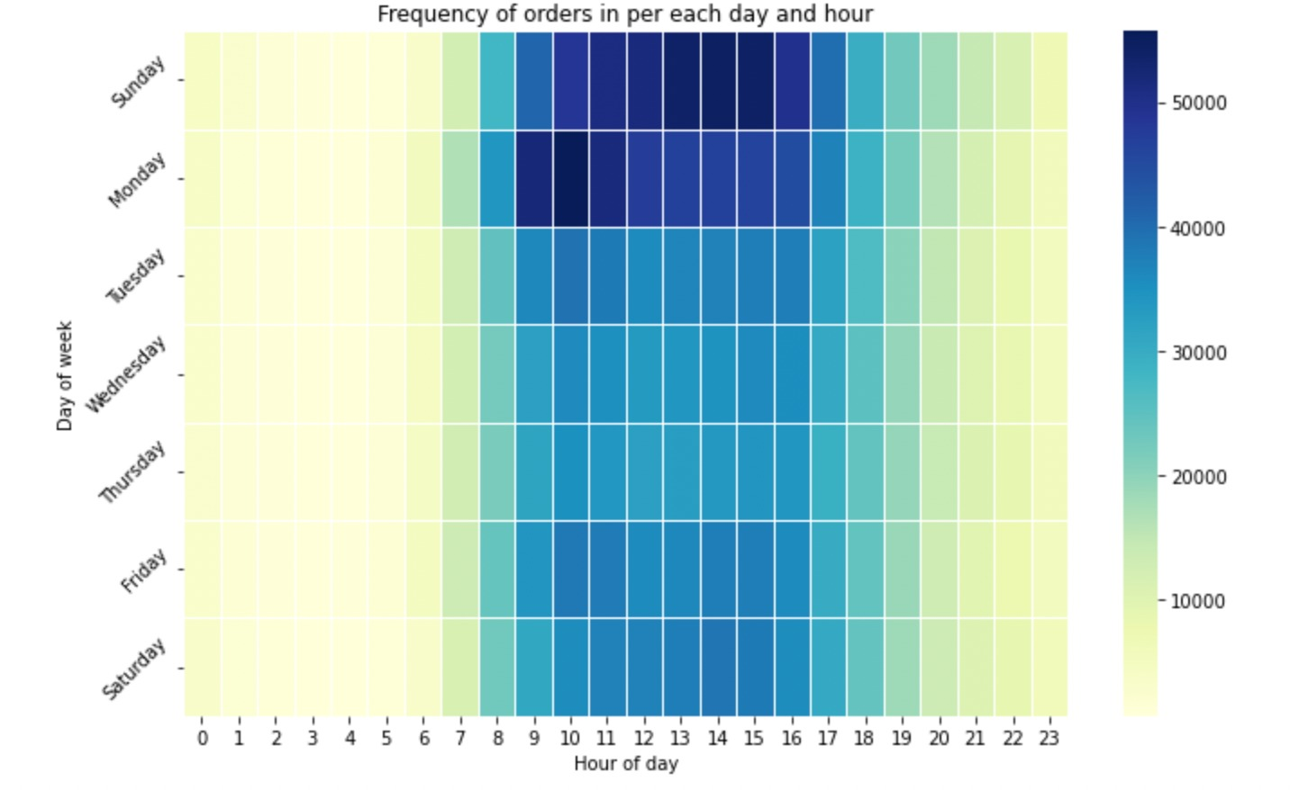
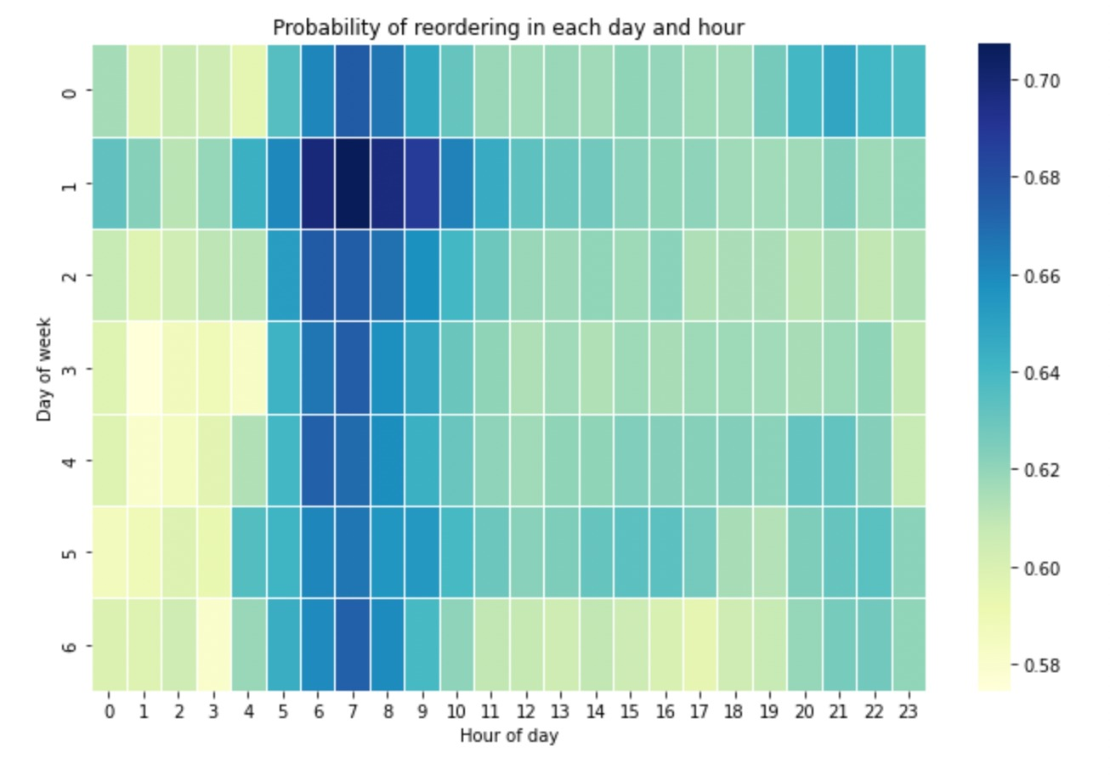
Bivariant Analysis

Slide 9
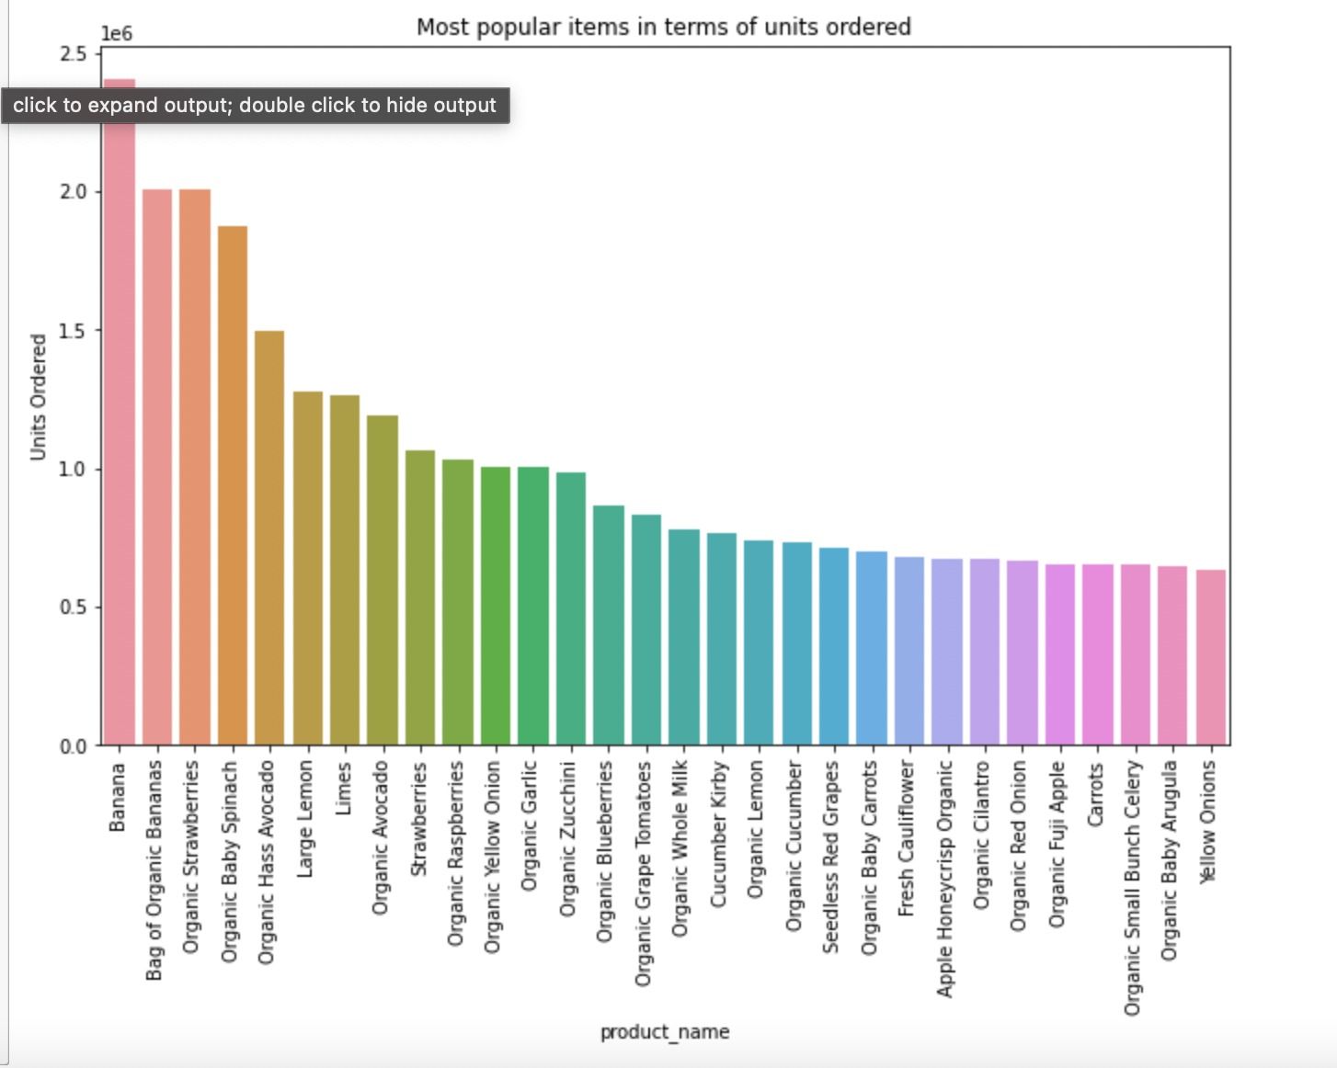
Analyzing products
How often a product is purchased?
5 Most Ordered Products
Banana
Bag of Organic Bananas
Organic Strawberries
Organic Baby Spinach
Organic Has Avocado
14% of all orders contains bananas.
Organic products are frequently ordered.

Slide 10
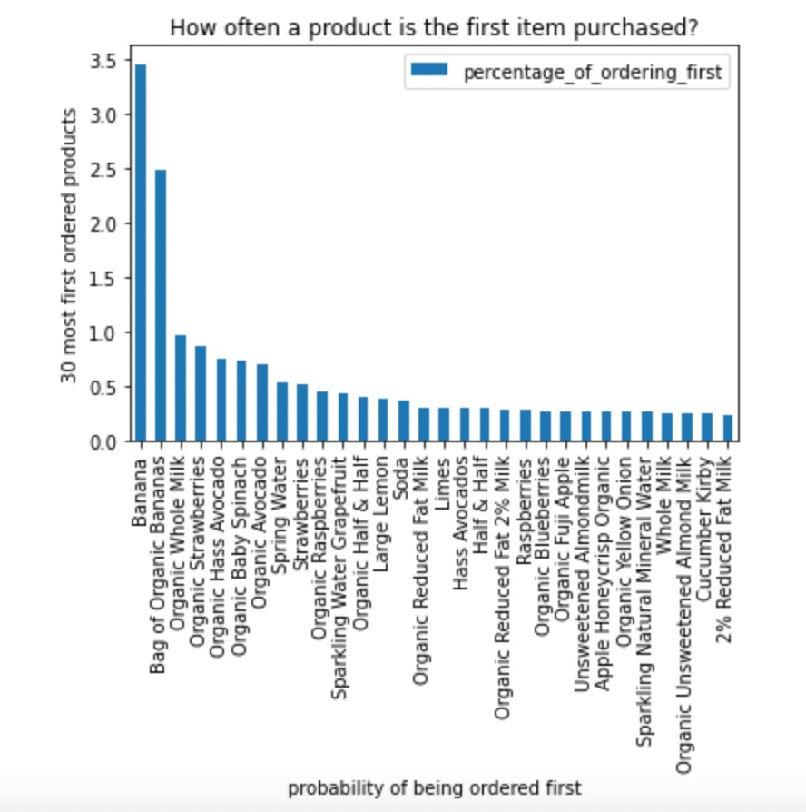
How often a product is the first item purchased?
5 Most Add to Cart First Products
Banana
Bag of Organic Bananas
Organic Whole Milk
Organic Strawberries
Organic Has Avocado
3.4% of the orders, Banana is being the first product added to cart.
Products containing milk have very high probability to be reordered.
Organic products have very high probability to be reordered.

Slide 11
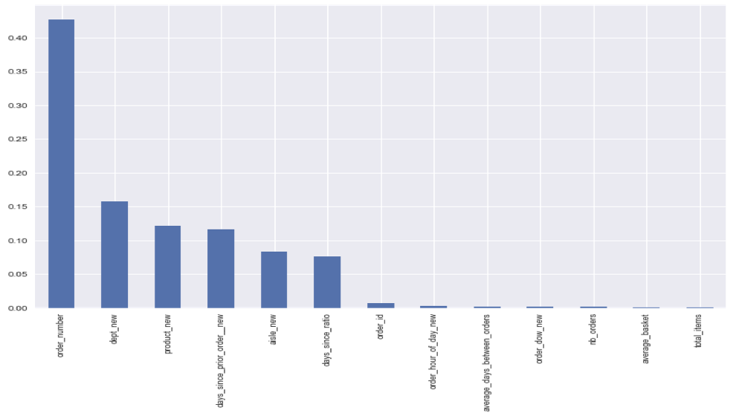
Important Features for Reordered Products
Top 5 important features are:
Order number
Department
Product
Days since prior order
Aisle

Slide 12
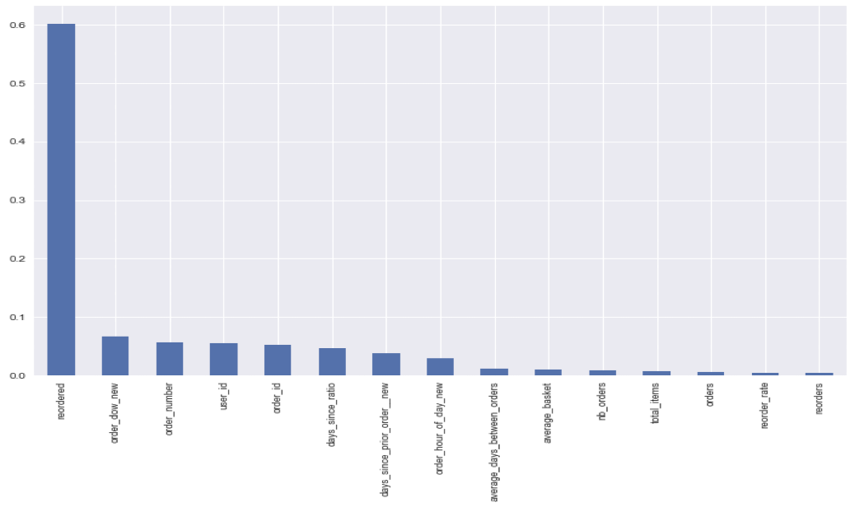
Important Features for department prediction
Top 5 important features are:
Reordered
Day of week
Order number
User id
Order id

Slide 13
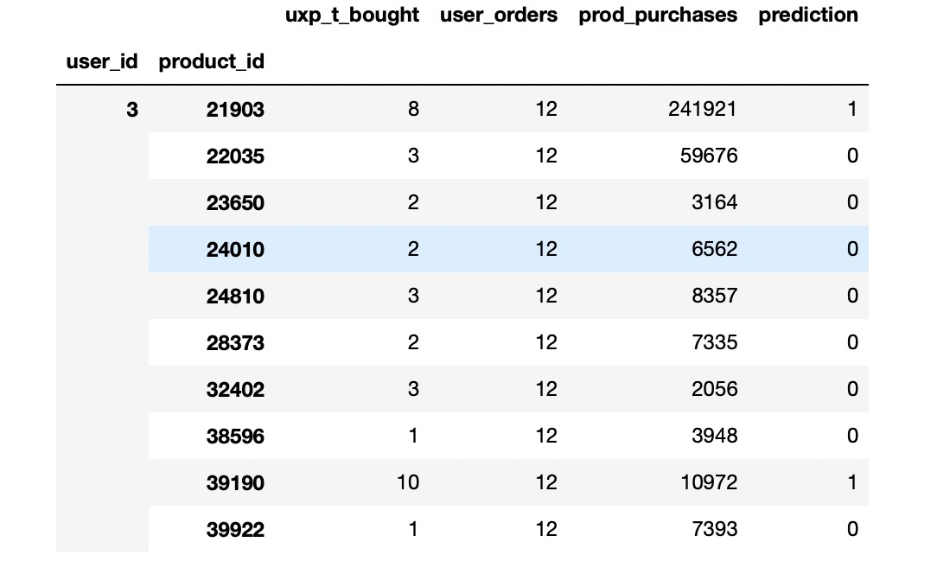
Logistic Regression
Based on the user_id we have predicted whether the user reordered the product or not.

Slide 14
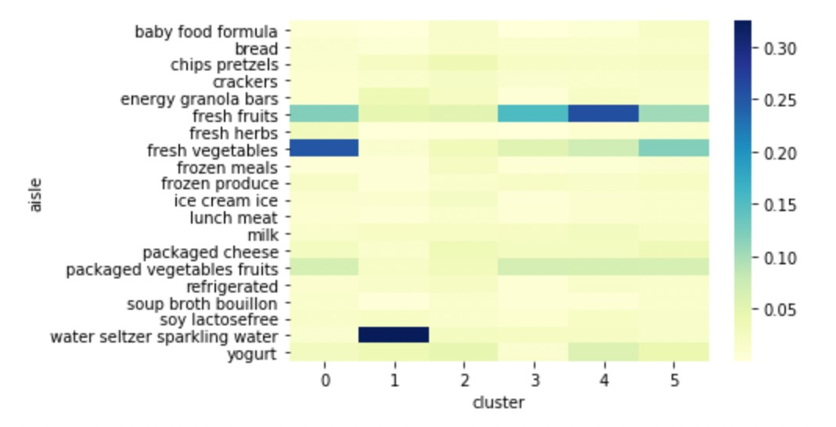
K-means Clustering
Heatmap for share of purchases by aisle for the top 20 Instacart aisles.

Slide 15
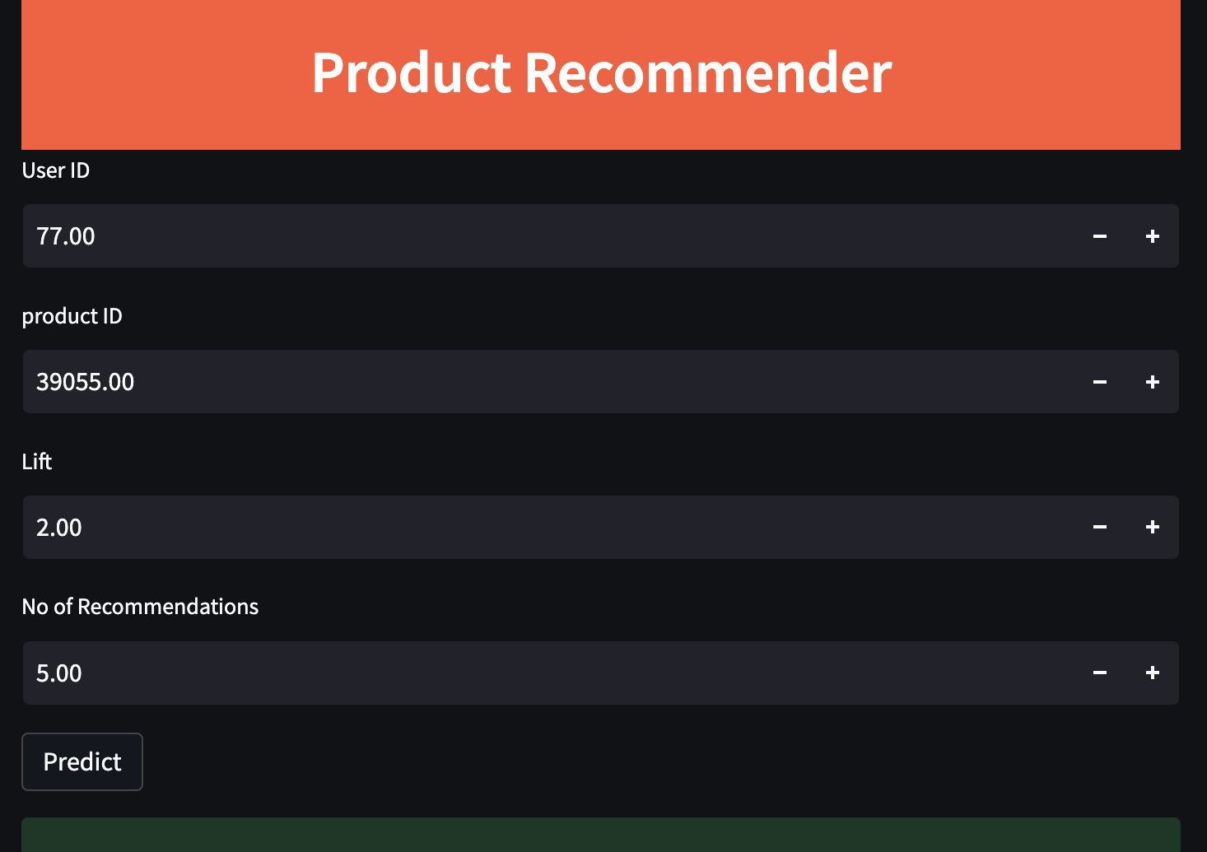
Product Recommender
Deployment of this application is done using Streamlit which is an open-source Python library that makes it easy to create and share beautiful, custom web apps for machine learning and data science.

Slide 16
Conclusion
Instacart is a web app and in web analytics , data reflects the way users behave, and the way they are encouraged to behave, by the decisions earlier made. Market Basket analysis can be used to drive business decision making by using the association results. There are number of ways in which MBA can be used :
Associated Aisles should be placed together on the web application platform to boost the sales and reduce the time spent in finding that Aisle. For instance, Cereal, lunch meat and Bread Aisle should be placed together, as they are highly associated.
Associated products such as Organic Cilantro and limes should be put close to one another, to improve the customer shopping experience and improving the store layout. Marketing can take benefit from these association relationship, for example target customers who buy Organic Cilantro with offers on Lime, to encourage them to spend more on their shopping basket.

Slide 17
Future Scope
For predicting whether a product is reordered or not, algorithms that predict binomial categories better can be used.
For predicting a multi-category variable like department, other multi-nominal algorithms can be applied.
New features could be created to help us generalize better on the test dataset thereby achieving better results.

Slide 18
References
https://www.kaggle.com/code/nouranhany10/eda-on-instacart-data
https://www.kaggle.com/c/instacart-market-basket-analysis/data?select=sample_submission.csv.zip
https://medium.com/mlearning-ai/instacart-market-basket-analysis-a726bb56d62

